Slide 1
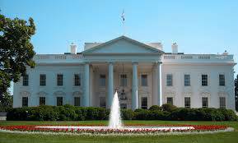
United States Presidency
Created by: Lindsay Olevitch
Notes:
Image taken from Wikimedia Commons (https://commons.wikimedia.org/wiki/File:White_House_DC.JPG) and edited by color saturation and resizing

Slide 2
Table of Contents
Executive Branch
Functions of the Executive Branch
Famous Presidents
Abraham Lincoln: champion for civil rights
Franklin D. Roosevelt: savior of the Great Depression
Infamous Presidents
Harry S. Truman: the ultimate bomber
Warren G. Harding: corruption at its finest
Additional information
Home

Slide 3
Executive Branch of Government
Article II of the Constitution
President as the figurehead
Vice President & Cabinet
Executes laws in the country
Home
Notes:
Image taken from Wikimedia commons (https://commons.wikimedia.org/wiki/File:Branches_US_gov.jpg) and edited by creating a highlighted area over the executive branch and president

Slide 4
Executive Functions
President
Head of State
Commander-in-chief
Foreign diplomat
Vice President
“President” of Senate
Take over if needed
Serve President as needed
Cabinet Members
Appointed by President
15 different departments
Running federal agencies
Home

Slide 5
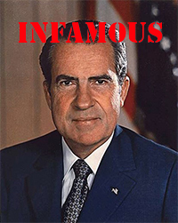
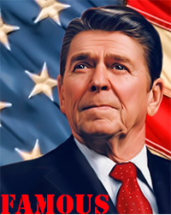
Famous Presidents
What makes a president famous?
What’s the difference between fame and infamy?
Fame:
Positive impact on society
Growth of the country
Cares for general well being
Infamy:
Remembered for a mistake or controversial decision
Poor presidency
Lack of growth or positive change
Home
Notes:
Reagan image taken from flickr: https://www.flickr.com/photos/carolinapixel/4313696073 and modified with text overlay “fame” and resized
Nixon image taken from flickr: https://www.flickr.com/photos/historyinanhour/4775027305 and modified with text overlay “infamy” and resized

Slide 6
Abraham Lincoln
Civil War Era leader
Freedom of enslaved peoples
Reunification of the nation
Assassinated at Ford’s Theatre
Legacy of a freedom fighter
Portrait of Abraham Lincoln
taken from Wikimedia Commons
Home
Notes:
Image taken from Wikimedia Commons (https://commons.wikimedia.org/wiki/File:Abraham_Lincoln_O-77_by_Gardner,_1863.jpg) and resized

Slide 7
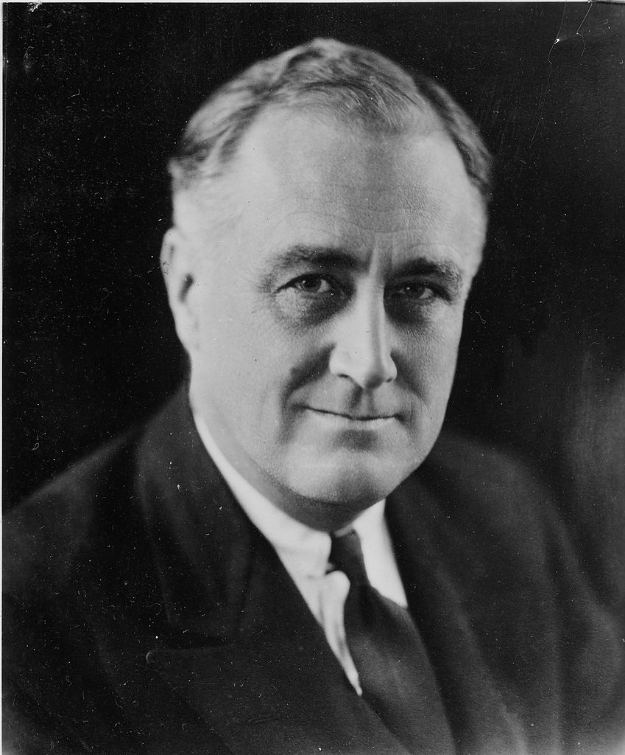
Franklin D. Roosevelt
New Deal legislation
Economic and social reform
World War II
4 Presidential Terms
Portrait of Franklin D. Roosevelt
taken from Wikimedia Commons
Home
Notes:
Image taken from Wikimedia Commons (https://commons.wikimedia.org/wiki/File:Franklin_D._Roosevelt_-_NARA_-_196715.jpg) and mirrored and resized

Slide 8
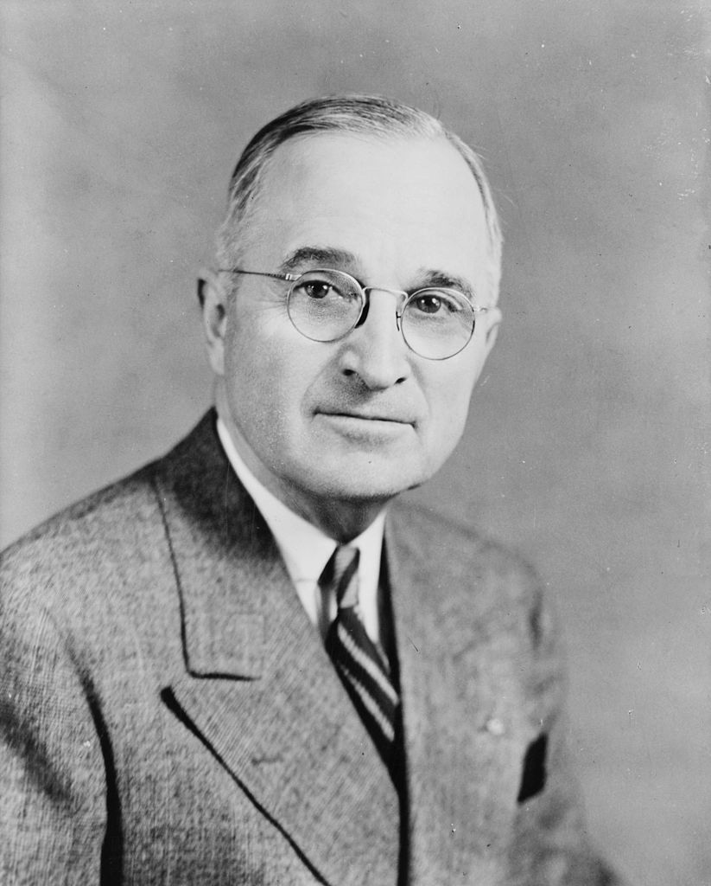
Harry S. Truman
Took over after FDR’s death
Manhattan Project
Controversial end to WWII
Hiroshima and Nagasaki
Beginning of the Cold War
Portrait of Harry S. Truman
taken from Wikimedia Commons
Home
Notes:
Image taken from Wikimedia Commons (https://commons.wikimedia.org/wiki/File:Harry_S_Truman,_bw_half-length_photo_portrait,_facing_front,_1945.jpg) and edited by mirroring and resizing

Slide 9
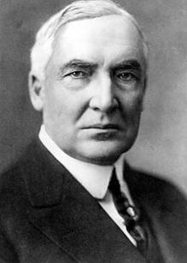
Warren G. Harding
Post WWI
Return to normalcy
Surrounded by trouble
Ohio Gang
Teapot Dome
Poor policies and decision making
Portrait of Warren G. Harding
taken from Wikimedia Commons
Home
Notes:
Image taken from Wikimedia Commons (https://commons.wikimedia.org/wiki/File:Warren_G._Harding.jpg) and edited by mirroring and resizing

Slide 10
For more information
Additional Info and Research
Contact the Author
Executive Branch:
White House official website
Presidents:
Information about each Presidential Term
Famous Presidents:
Information regarding Presidential rankings
For more information please email:
Lindsay_Olevitch@knights.ucf.edu
Home

